Slide 2
Open Source Cisco SD-WAN Multi-cloud Automation for MSPs
Secure Industrial Pipelining of multi-tenancy SD-WAN for MSPs in Azure, GCP, and AWS
Sherri Conrod, TSA & Programmability Lead
LTRAPP-3000

Slide 3

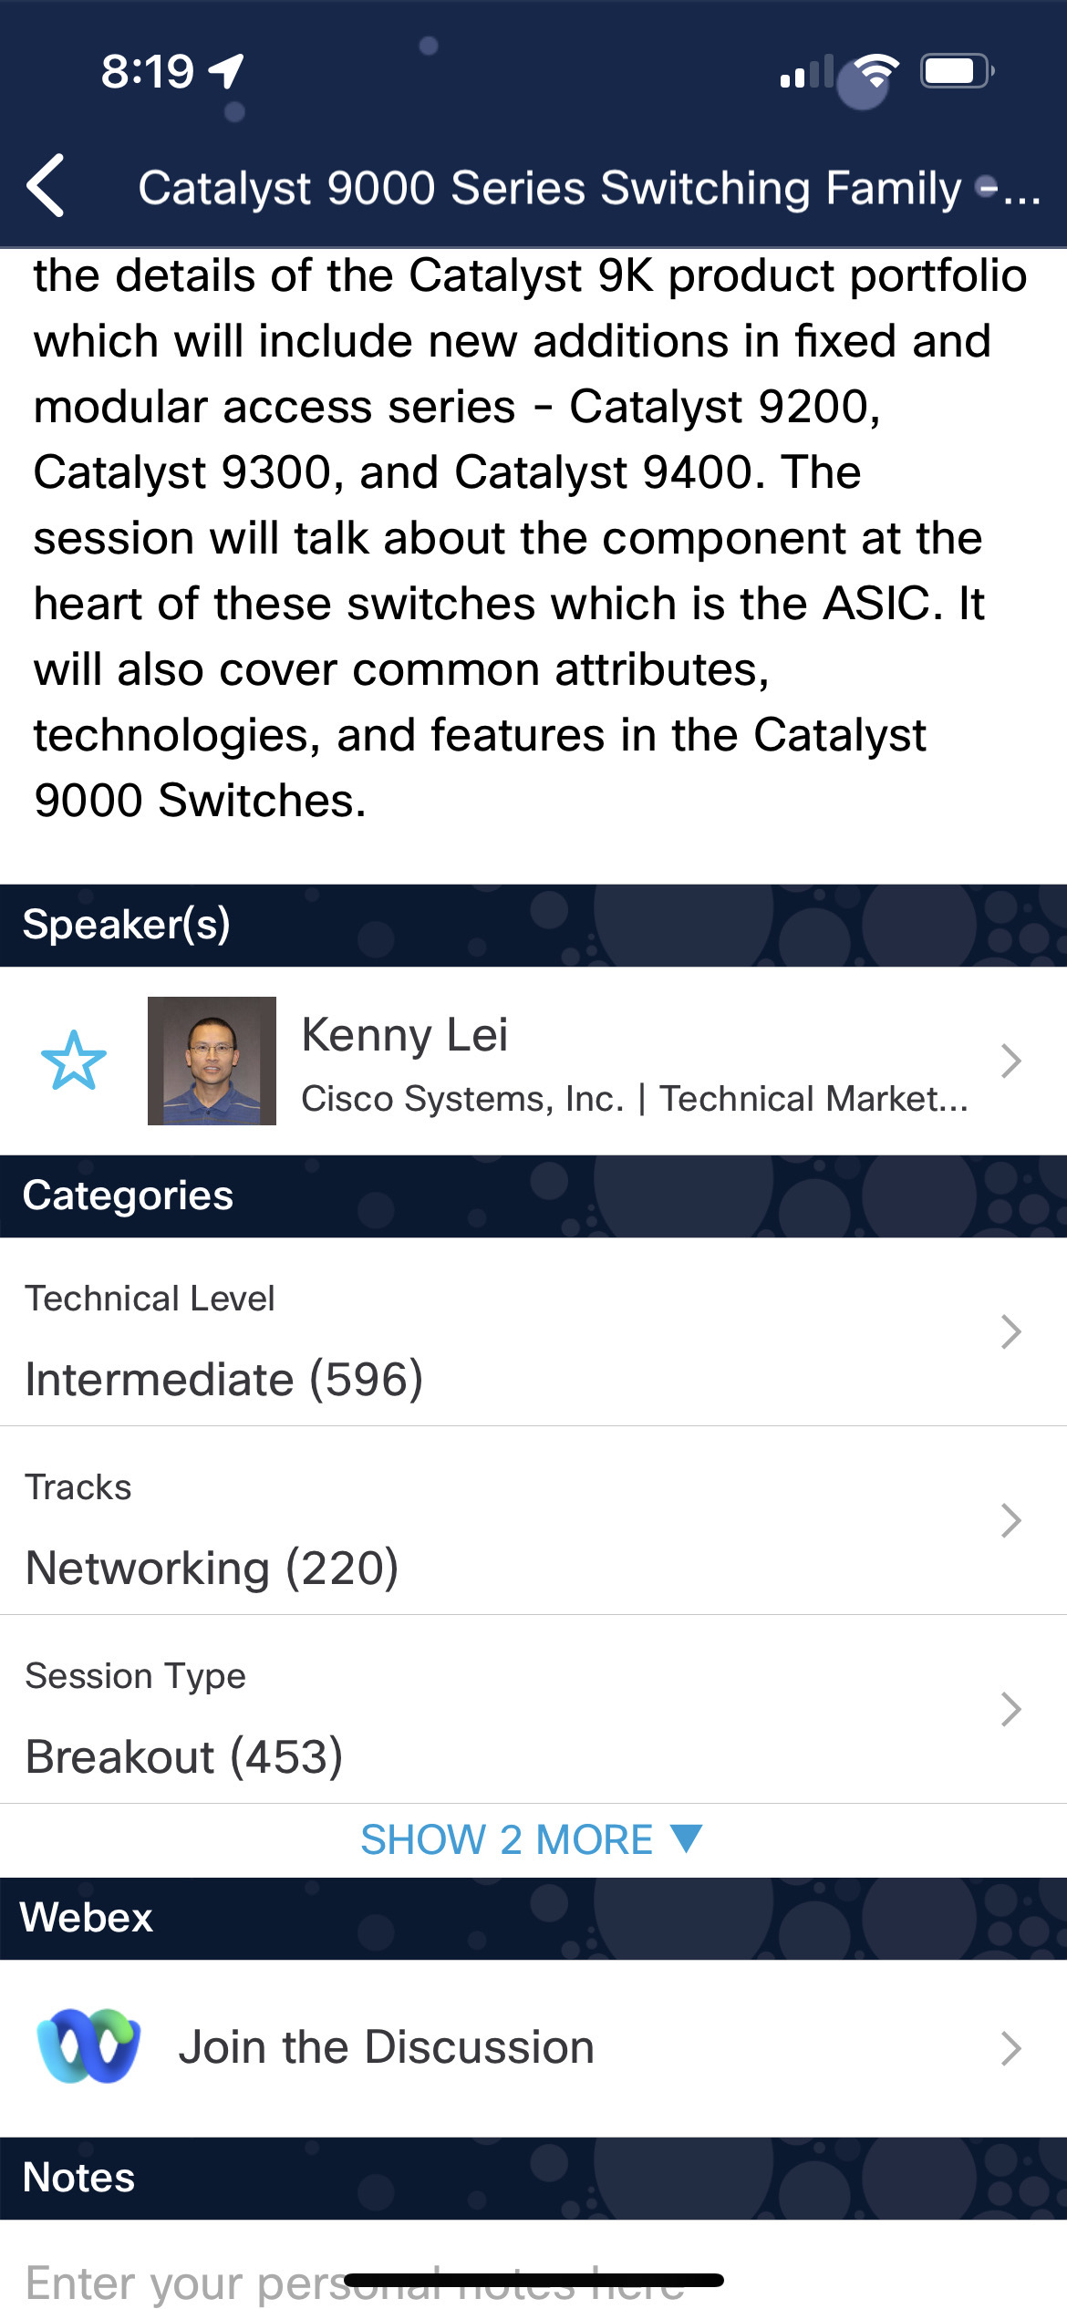
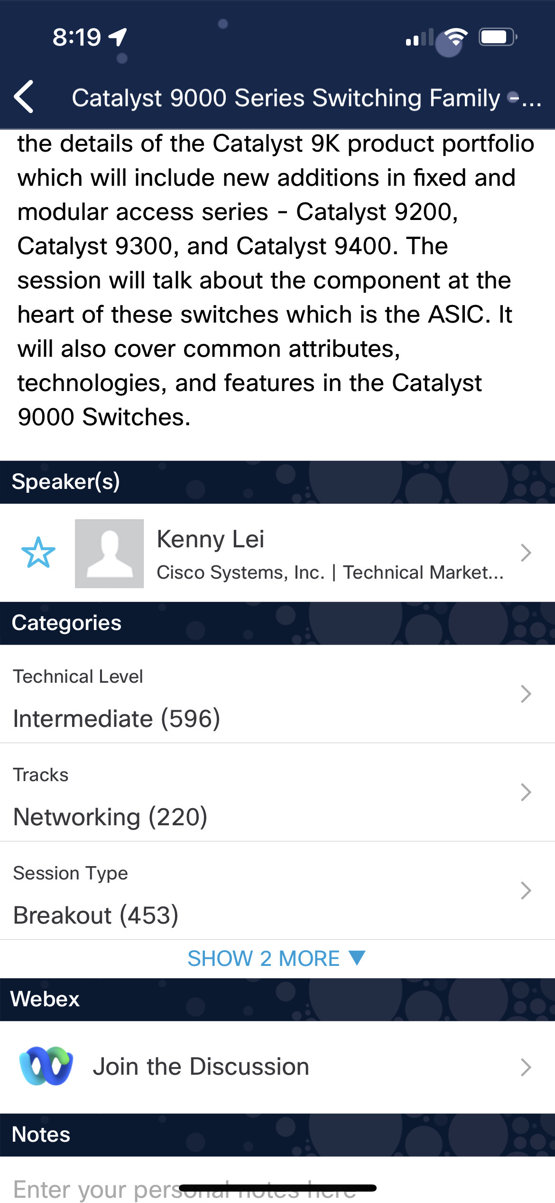

Cisco Webex App
Questions? Use Cisco Webex App to chat with the speaker after the session
How
1
Find this session in the Cisco Live Mobile App
Click “Join the Discussion”
Install the Webex App or go directly to the Webex space
Enter messages/questions in the Webex space
2
3
Enter your personal notes here
4
Webex spaces will be moderated by the speaker until June 9, 2023.
https://ciscolive.ciscoevents.com/ciscolivebot/#LTRAPP-3000
© 2023 Cisco and/or its affiliates. All rights reserved. Cisco Public
3

Slide 4
“we cannot solve our problems with the same thinking we used when we created them.”
Albert Einstein

Slide 5
Introduction
Lab Intro
SD-WAN Prep – Automated Deployment of Underlays to AWS, GCP, and Azure
SD-WAN Deployment:
AWS
Azure
GCP
Monetization SD-WAN

Slide 6
Introduction

Slide 7
Introduction
SD-WAN is the ideal solution for deploying managing and monitoring a cloud WAN especially for overlay solutions such as Cloud Foundry that require a flat networking model
Challenges:
To prepare an underlay and deploy the SD-WAN manually via a manual GUI legacy point and click workflow is time slow and error prone and has both security and business continuity
Companies launching new MSP monetization of SD-WAN require an automated multi-tenancy open-source code base to quickly deploy and evaluate the solution and integrate it with their existing Devops and Netops Frameworks
Solution:
Automation of deployments of the underlay and overlay SD-WAN from code is faster, less prone to human error, and can be iterated on rapidly to improve Business Continuity and improve Delivery and accelerated monetization of SD-WAN solutions.
Decoupling of the underlay from the overlay allows for the ease of deploying a flat network across multiple cloud providers.
Automation allows for monetization of SD-WAN and related services via your marketplace, allowing you to realize revenue rapidly

Slide 8
Objectives
At the completion of this Lab you will have successfully:
Deployed all underlay pre-requisites for SD-WAN into AWS, Azure, GCP via code in your Industrial Pipeline
Deployed Cisco Viptela SD-WAN into AWS, Azure, GCP using an Open Source, Secure Industrial Pipeline
Understand all pre-requisites and components along with the workflow sequence into all three Cloud Providers: AWS, Azure, GCP
Understand the component block architecture of a SECURE Industrial Pipeline and SDLC Agile workflow and How to Monetize SD-WAN

Slide 9
Video

Slide 10
SD-WAN Deployment Preparation Deploying Underlay to Cloud Providers

Slide 11
Lab Part 1 – Cloud Provider Underlay Prep
Clone the Lab Git Repository
Open your IntelliJ IDE and open the folder LTRAP300 (You have full access to this repository). Open the Terminal in the IDE and type:
git clone https://devops-ontap/SD-WAN
cd SD-WAN
git checkout your branch (branch names will be assigned day of the lab by Instructor)
Git Checkout the lab guides:
git checkout https://github.com/devops-ontap/LTRAPP3000.git
2. Browse to the directory: lab-guide
Open ”deploy-underlay.md” and and wait for the instructor to provide verbal overview of next steps and live demo before proceeding
STOP – WAIT – Please do not proceed until Instructor has delivered verbal instruction and demo. Working ahead in this lab will result in your environment needing to be rebuilt

Slide 12
Lab Part 1 – Cloud Provider Underlay Prep
Clone the Lab Guide
git checkout https://github.com/devops-ontap/LTRAPP3000.git
2. Browse to the directory: lab-guide
Open ”deploy-underlay.md” and and wait for the instructor to provide verbal overview of next steps and live demo before proceeding
STOP – WAIT – Please do not proceed until Instructor has delivered verbal instruction and demo. Working ahead in this lab will result in your environment needing to be rebuilt

Slide 13
Demo Instructor Demonstrates Steps to Deploy Underlays

Slide 14
Deploy SD-WAN to AWS

Slide 15
Lab Part 2 – Deploy SD-WAN to AWS
All steps required to deploy the SD-WAN to AWS exist in the Lab Guide in
“aws-SD-WAN-deploy.md”
Open ”aws-SD-WAN-deploy.md” and wait for the instructor to provide verbal overview of next steps detailed in the readme file and completes the live demo before proceeding

Slide 16
Demo Instructor Demonstrates Steps to Deploy SD-WAN to AWS

Slide 17
Deploy SD-WAN to Azure

Slide 18
Lab Part 3 – Deploy SD-WAN to Azure
All steps required to deploy the SD-WAN to Azure exist in the Lab Guide in
“azure-SD-WAN-deploy.md”
Open ”azure-SD-WAN-deploy.md” and wait for the instructor to provide verbal overview of next steps detailed in the readme file and completes the live demo before proceeding

Slide 19
Demo Instructor Demonstrates Steps to Deploy SD-WAN to Azure

Slide 20
Deploy SD-WAN to GCP

Slide 21
Lab Part 4 – Deploy SD-WAN to GCP
All steps required to deploy the SD-WAN to Azure exist in the Lab Guide in
“gcp-SD-WAN-deploy.md”
Open ”gcp-SD-WAN-deploy.md” and wait for the instructor to provide verbal overview of next steps detailed in the readme file and completes the live demo before proceeding

Slide 22
Demo Instructor Demonstrates Steps to Deploy SD-WAN to GCP

Slide 23



Fill out your session surveys!
Attendees who fill out a minimum of four session surveys and the overall event survey will get Cisco Live-branded socks (while supplies last)!
Attendees will also earn 100 points in the Cisco Live Game for every survey completed.
These points help you get on the leaderboard and increase your chances of winning daily and grand prizes

Slide 25

Continue your education
Visit the Cisco Showcase for related demos
Book your one-on-one Meet the Engineer meeting
Attend the interactive education with DevNet, Capture the Flag, and Walk-in Labs
Visit the On-Demand Library for more sessions at www.CiscoLive.com/on-demand

